Slide 1
WPI Command Based Framework
Component Based Design and Design Patterns
Sam Chen and Donald Lutz
Team 1410 – Release the Kraken

Slide 2
Important Robot Control Components
Sensors
Actuators
Electrical Components
Chassis
cRIO
Driver Station
Input / Output devices

Slide 3
C++ and WPI Links
C++ Links:
http://www.cplusplus.com/doc/tutorial/
http://www.cprogramming.com/tutorial/c++-tutorial.html
WPLIB links:
http://firstforge.wpi.edu/sf/docman/do/listDocuments/projects.wpilib/docman.root.c_and_java_documentation

Slide 4
Component Based Robotic Systems
http://www.best-of-robotics.org/pages/publications/brugali12reuseoriented.pdf
http://www.best-of-robotics.org/pages/publications/UniBergamo_Component_Robotics_RA-Magazine_2009.pdf
http://www.best-of-robotics.org/pages/publications/UniBergamo_HBRS_Component_Robotics_P2_RA-Magazine_2010.pdf

Slide 5
Component Software Design
Szyperski C.,"Component Software, Beyond Object-Oriented Programming"
“A software component is a unit of composition with contractually speciﬁed interfaces and explicit context dependencies only. A software component can be deployed independently and is subject to composition by third parties".

Slide 6
Component Software Design Principles
A software component is a piece of software that has been independently developed from where it is going to be used.
It offers a well defined interface that hides its internals, and it is independent of context until instantiation time.
It can be deployed without modifications by third parties.
It needs to come with a clear specification of what it requires and provides in order to be able to be composed with other components.

Slide 7
Component Software for the FRC Developers
It isolates problems in a divide and conquer way. A single component is supposed to solve only a single task and the whole application is built creating a system made of components which work together.
Component based system are flexible since they are easier to design and to maintain than monolithic applications.
It makes concurrency easier. Almost all of the robotic systems need concurrent access to devices and resources.
Component based frameworks hides the complexity of inter-process and inter-thread communication. Thus, they make distributed systems easier to create and design.
It promotes the reusability of software on different platforms and inside different applications.

Slide 8
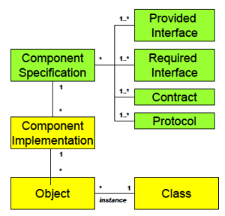
Component Software View

Slide 9
Design Patterns
A design pattern is a general reusable solution to a commonly occurring problem within a given context in software design. A design pattern is not a design that can be transformed directly into source code. It is a template for how to solve a problem that can be used in many different problem domains. Patterns are formalized best practices that can be implemented within an application or framework.

Slide 10
Command Design Pattern
Design Patterns: Elements of Reusable Object-Oriented Software – Authors (Erich Gamma, Richard Helm, Ralph Johnson, John Vlissides)
Encapsulate a request as an object, thereby letting you parameterize clients with different requests, queue or log requests, and support undoable operations.

Slide 11
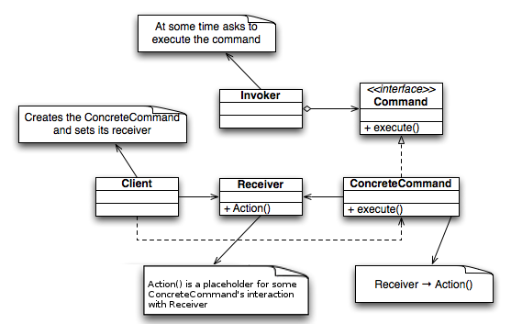
Command Design Patten Diagram

